Slide 1



Your experience
with Kargo

Slide 2





Bas Bremer
Cloud Native Engineer
b.bremer@fullstaq.com
www.linkedin.com/in/bas-bremer
fullstaq.com

Slide 3

Hidde Beydals
Staff Software Engineer (Kargo)
Hidde@akuity.io
https://www.linkedin.com/in/hiddebeydals
fullstaq.com

Slide 4

Table of Content
What is Kargo?
01
For who is Kargo?
02
How does Kargo Work?
03
Key concepts
04
Demo time!
05
Conclusion
06
fullstaq.com

Slide 5

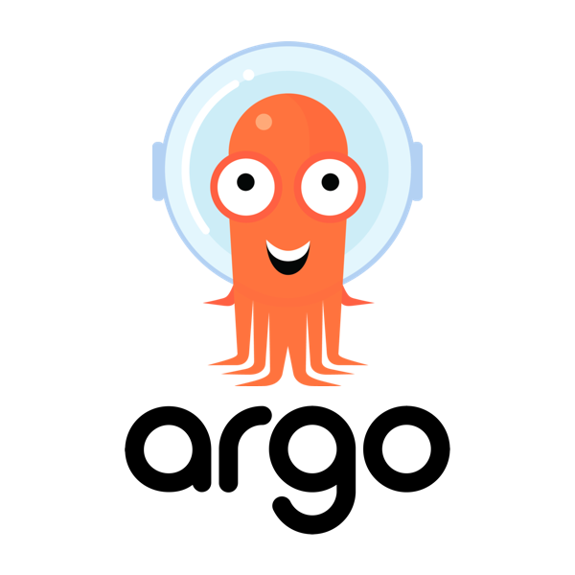

Who knows ArgoCD?
fullstaq.com

Slide 6

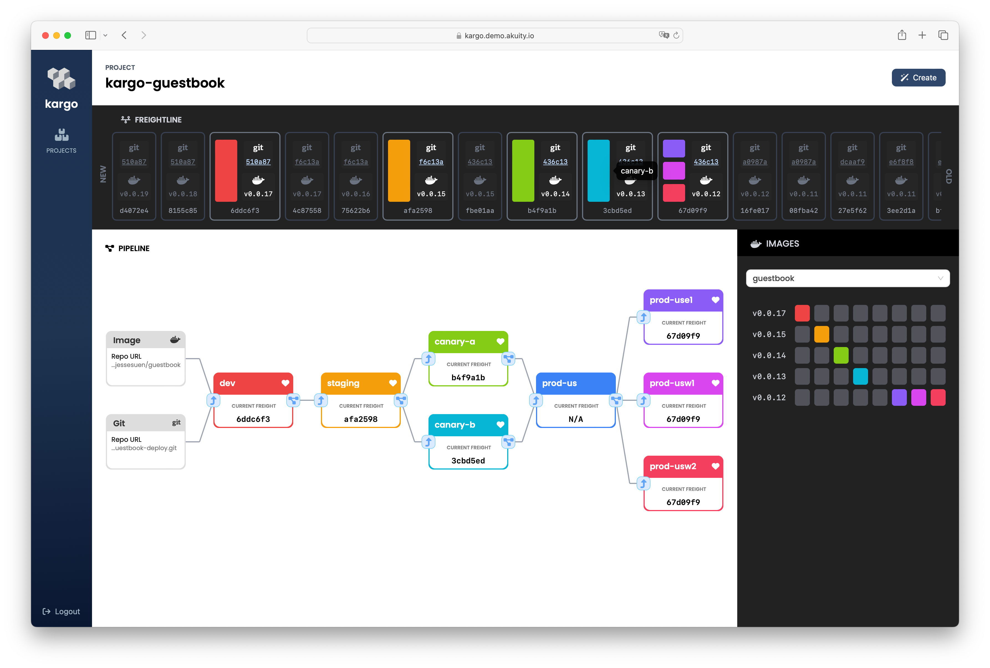
Who knows Kargo?
fullstaq.com

Slide 7

What is Kargo?
Kargo is a next-generation continuous delivery and application lifecycle orchestration platform for Kubernetes.
Kargo provides:
GitOps way of working
Flexible pipeline to promote changes in multiple stages
Dashboard for visualizing changes across your stages
Intuitive UX that hides nuances of GitOps
Safer deployments with enforced processes and guardrails
Testing and verification between stages
source: https://www.youtube.com/watch?v=Pto7QnxkjjA
fullstaq.com

Slide 8
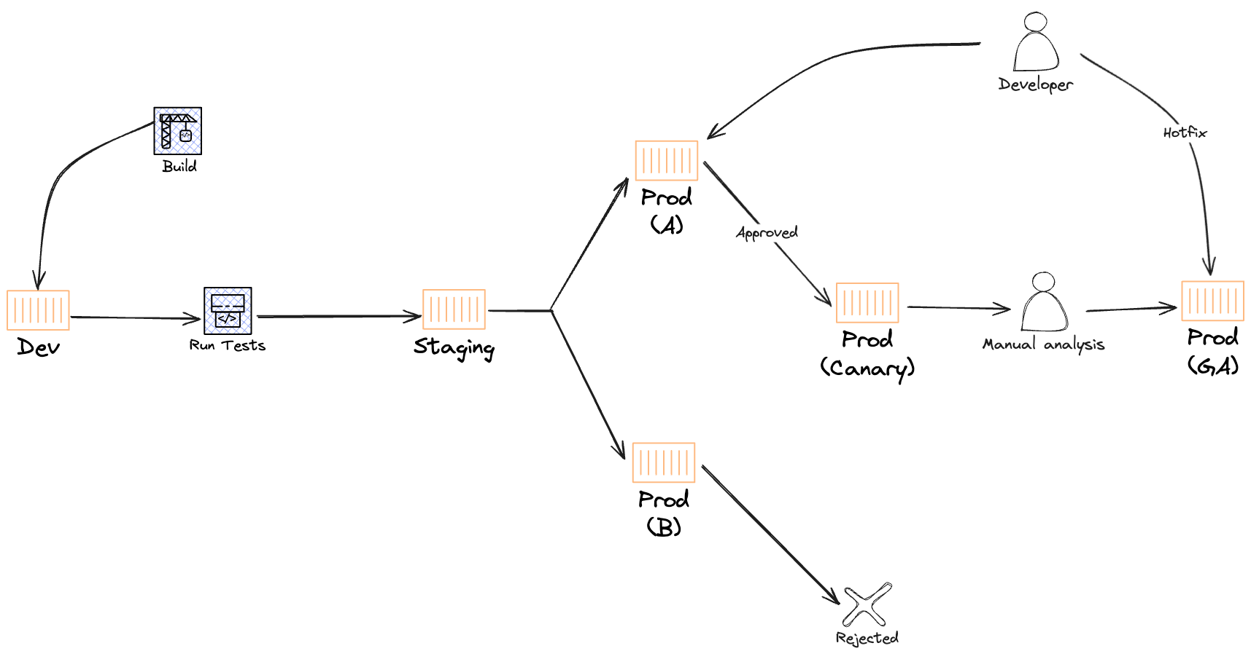
For who is Kargo?
Deploy pipelines are getting more complex!
When you have multiple environments and regions to deploy to.
When advanced promotion techniques are desired, such as:
Progressive Delivery: A/B testing, Canary
Continuous Verification
source: https://www.youtube.com/watch?v=Pto7QnxkjjA
fullstaq.com

Slide 9
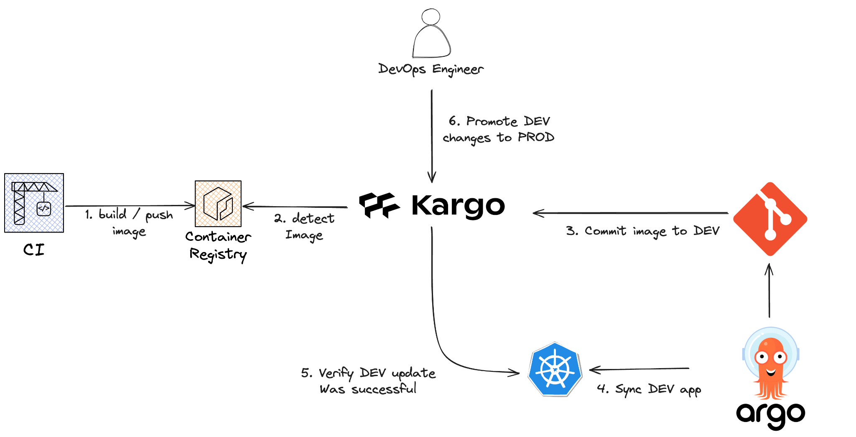
How does Kargo work?
source: https://www.youtube.com/watch?v=yaZc0DdeLKk
fullstaq.com

Slide 10
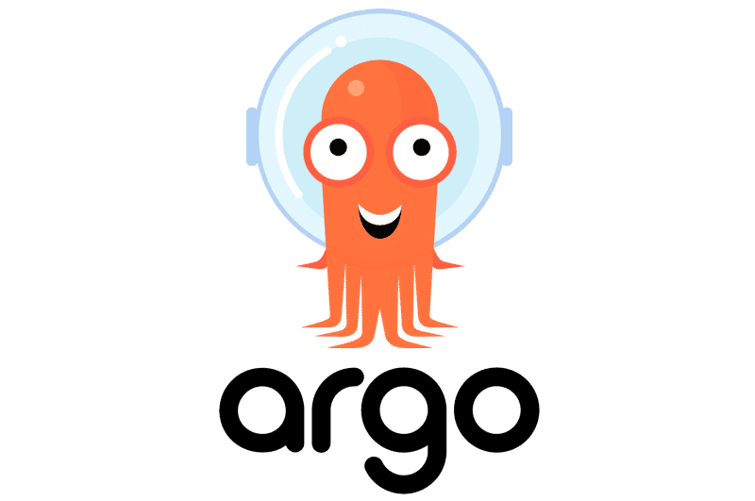
What about ArgoCD?
It does:
Deploy changes from git to a single target environment
It doesn’t:
Understand relationships between multiple deploy targets
Provide a pipeline to orchestrate changes
Write changes to git (it only read them)
Verify updates after the deploy completes
source: https://www.youtube.com/watch?v=yaZc0DdeLKk
fullstaq.com

Slide 11
Key concepts - Project
Collection of related Kargo resources such as:
RBAC
Stages
Warehouses
Freight
Creates a Kubernetes namespace
source: https://kargo.akuity.io/concepts
fullstaq.com
Notes:
A project is a collection of related Kargo resources that describe one or more delivery pipelines and is the basic unit of organization and tenancy in Kargo.
RBAC rules are also defined at the project level and project administrators may use projects to define policies, such as whether a stage is eligible for automatic promotions of new freight.

Slide 12
Key concepts - Freight
Freight is Kargo's second most important concept. A single "piece of freight" is a set of references to one or more versioned artifacts, which may include one or more:
Container images (from image repositories)
Kubernetes manifests (from Git repositories)
Helm charts (from chart repositories)
Freight can therefore be thought of as a sort of meta-artifact. Freight is what Kargo seeks to progress from one stage to another.
source: https://kargo.akuity.io/concepts
fullstaq.com

Slide 13
Key concepts - Warehouse
A warehouse is a source of freight. A warehouse subscribes to one or more:
Container image repositories
Git repositories
Helm charts repositories
Anytime something new is discovered in any repository to which a warehouse subscribes, the warehouse produces a new piece of freight.
source: https://kargo.akuity.io/concepts
fullstaq.com

Slide 14
Key concepts - Stage
A stage resource defines the subscription and promotion mechanisms for an instance of an application.
The critical feature of a stage is that its name (e.g. "test", "prod") denotes an application instance's purpose and not its location.
Typical stages are:
Dev
Test
Staging
Production
Can contain verification
Subscription to freight or another stage
Kargo’s most important concept
source: https://kargo.akuity.io/concepts
fullstaq.com
Notes:
When you hear the term “environment”, what you envision will depend significantly on your perspective. To eliminate confusion, Kargo avoids the term "environment" altogether in favor of stage. The important feature of a stage is that its name ("test" or "prod," for instance) denotes an application instance's purpose and not necessarily its location. This blog post discusses the rationale behind this choice.
Stages are Kargo's most important concept. They can be linked together in a directed acyclic graph to describe a delivery pipeline. Typically, such a pipeline may feature a "test" or "dev" stage as its starting point, with one or more "prod" stages at the end.

Slide 15
Key concepts - Promotion
A promotion is a request to move a piece of freight into a specified stage.
source: https://kargo.akuity.io/concepts
fullstaq.com

Slide 16
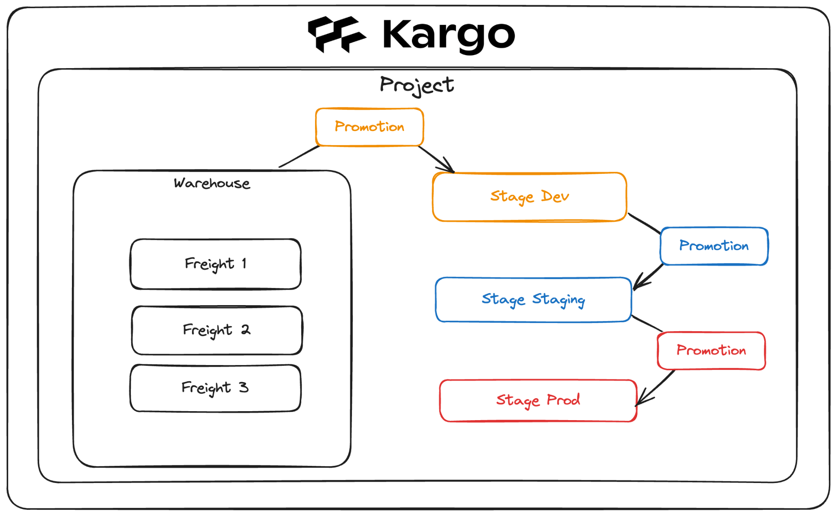
Key concepts - Architecture
fullstaq.com

Slide 17

fullstaq.com

Slide 18

QUESTIONS
fullstaq.com

